Slide 1
ENDOCRINE SYSTEM
Al-Farabi Kazakh National University
Higher School of Medicine

Slide 2
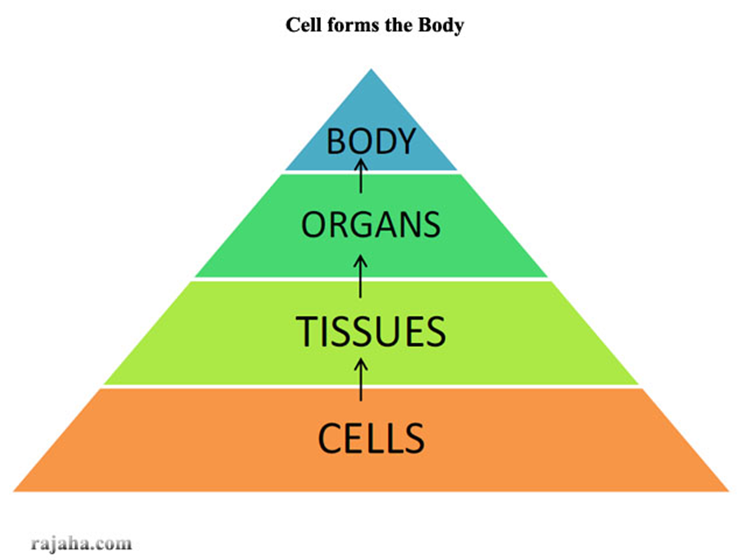

Slide 3
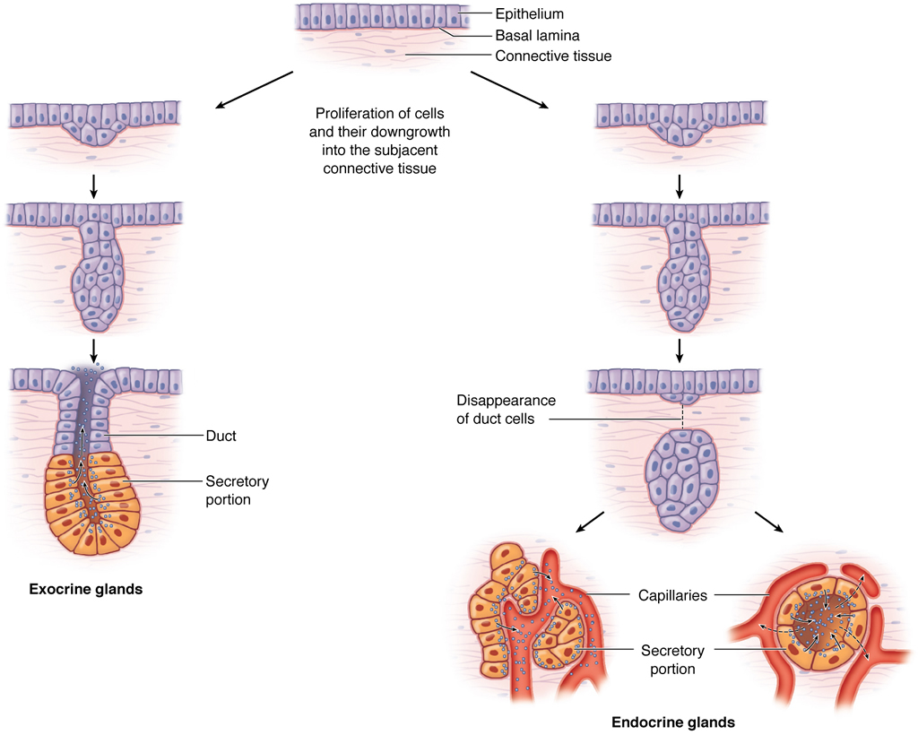

Slide 4
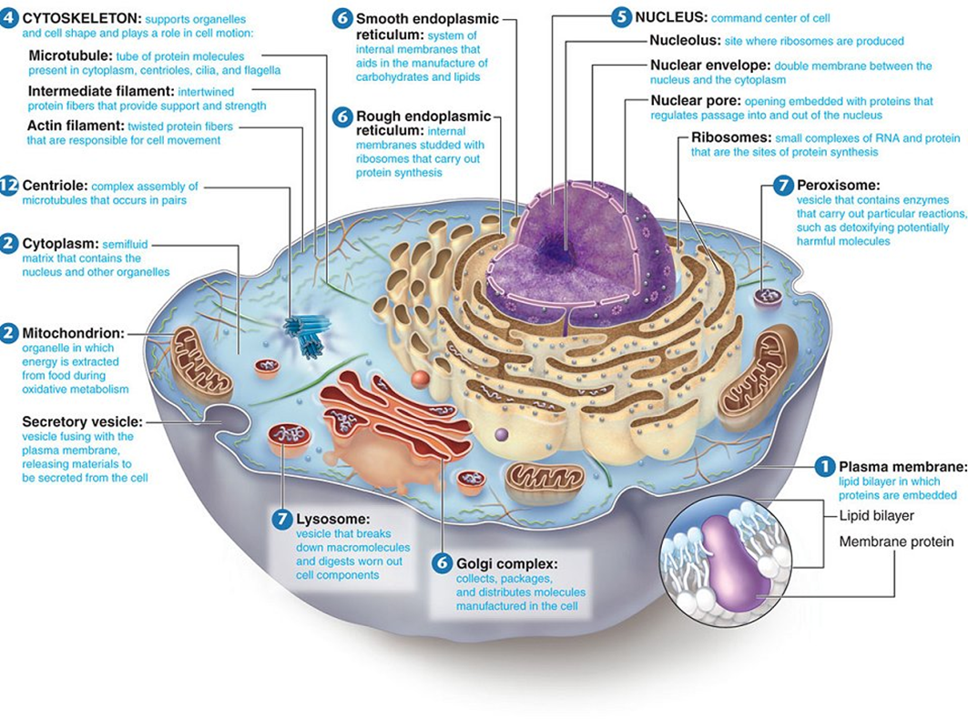

Slide 5
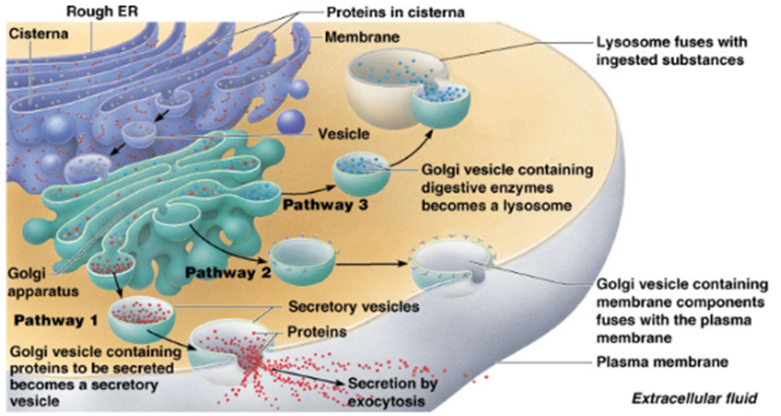

Slide 7
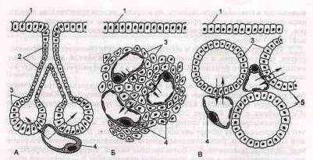

Slide 8
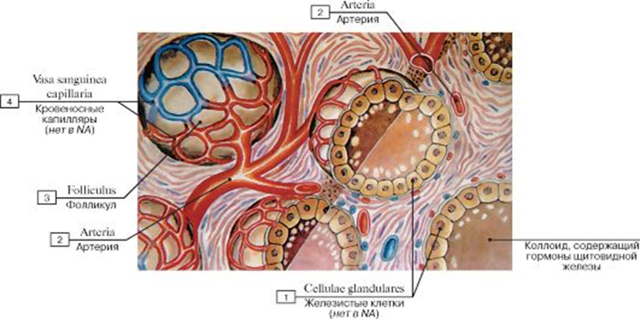

Slide 11
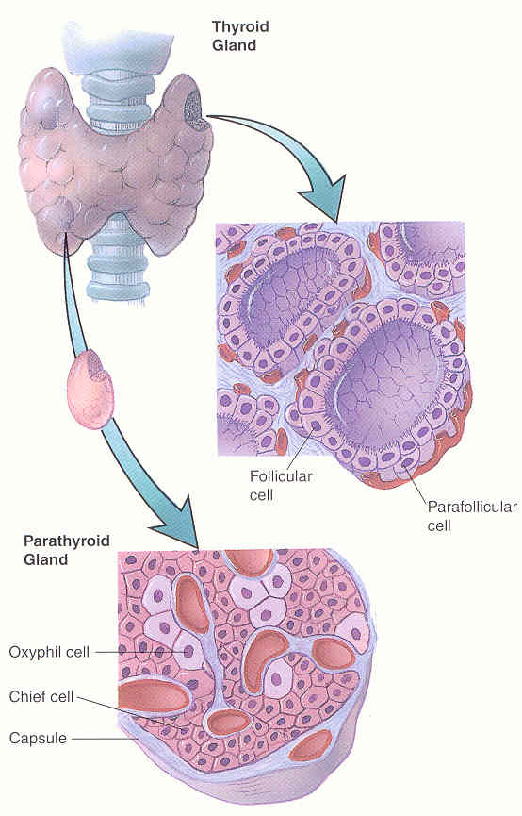

Slide 12
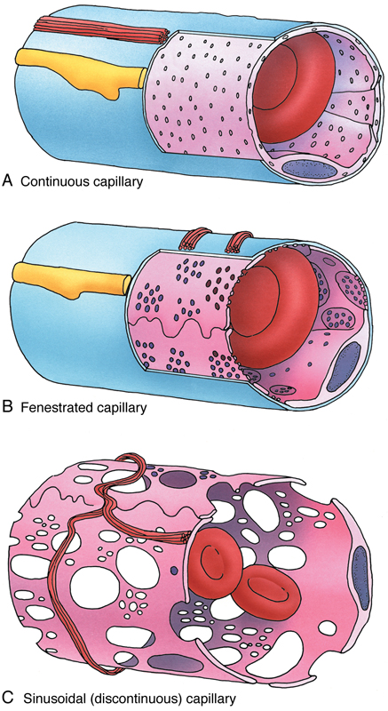
Capillaries
Capillaries are of three types, namely continuous, fenestrated, and sinusoidal.
Continuous capillaries are present in muscle, nervous, and connective tissues, whereas in the brain tissue they are classified as modified continuous capillaries. The intercellular junctions between their endothelial cells are a type of fasciae occludentes, which prevent passage of many molecules. Substances such as amino acids, glucose, nucleosides, and purines move across the capillary wall via carrier-mediated transport. There is evidence that barrier regulation resides within the endothelial cells but is influenced by products formed by the astrocytes associated with the capillaries.
Fenestrated capillaries have pores (fenestrae) in their walls that are 60 to 80 nm in diameter and covered by a pore diaphragm. These capillaries are found in the pancreas, intestines, and endocrine glands. The pores in fenestrated capillaries are bridged by a diaphragm. An exception is the renal glomerulus, composed of fenestrated capillaries that lack diaphragms.
Because of their location, sinusoidal capillaries have an enlarged diameter. They also contain many large fenestrae that lack diaphragms; the endothelial wall may be discontinuous, as is the basal lamina, permitting enhanced exchange between the blood and the tissues. Sinusoids are lined by endothelium. Although the endothelial cells lack pinocytotic vesicles, macrophages may be located either in or along the outside of the endothelial wall.
For more information see Capillaries in Chapter 11 of Gartner and Hiatt: Color Textbook of Histology, 3rd ed. Philadelphia, W.B. Saunders, 2007.
Figure 11–12 The three types of capillaries: continuous, fenestrated, and sinosoidal (discontinuous).

Slide 13
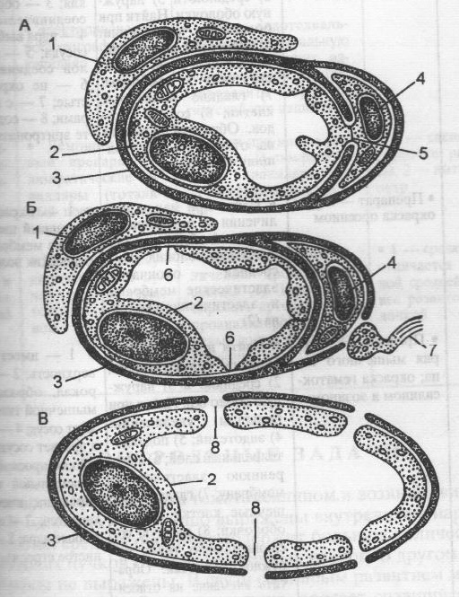

Slide 15
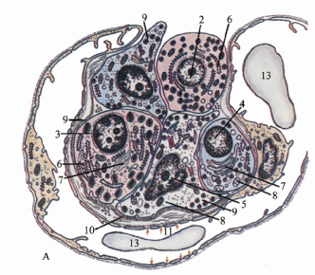

Slide 17
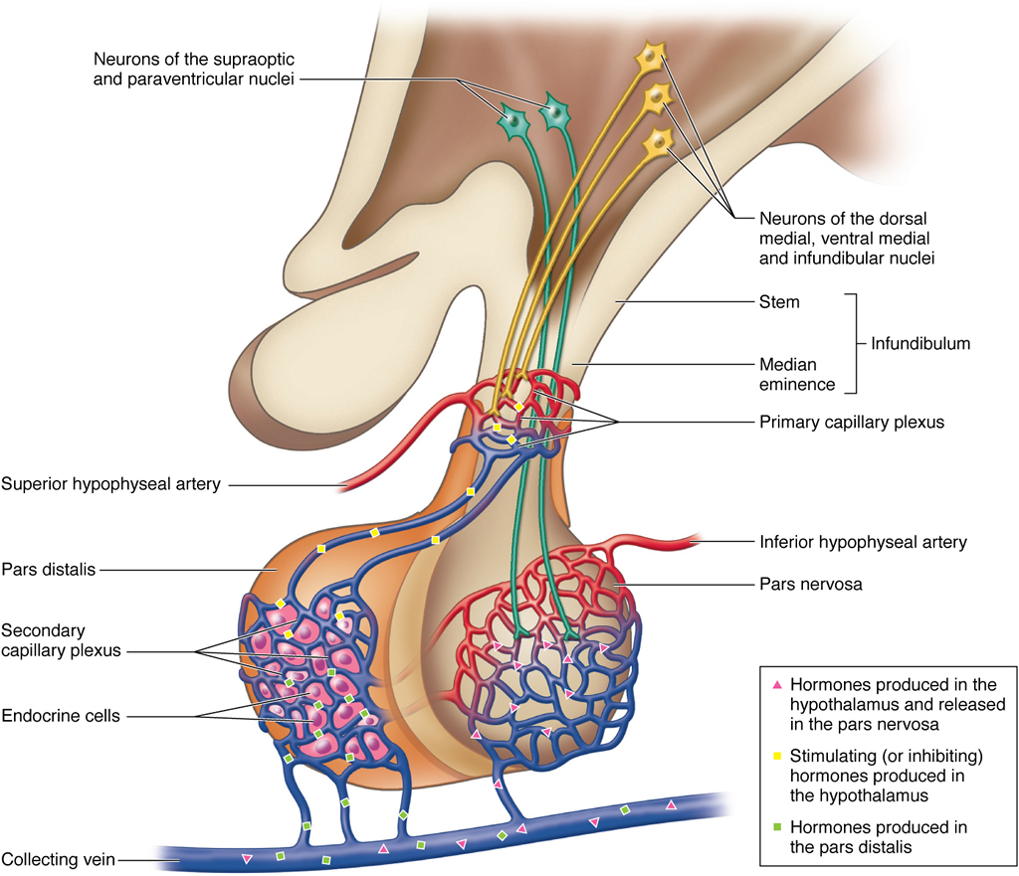

Slide 18
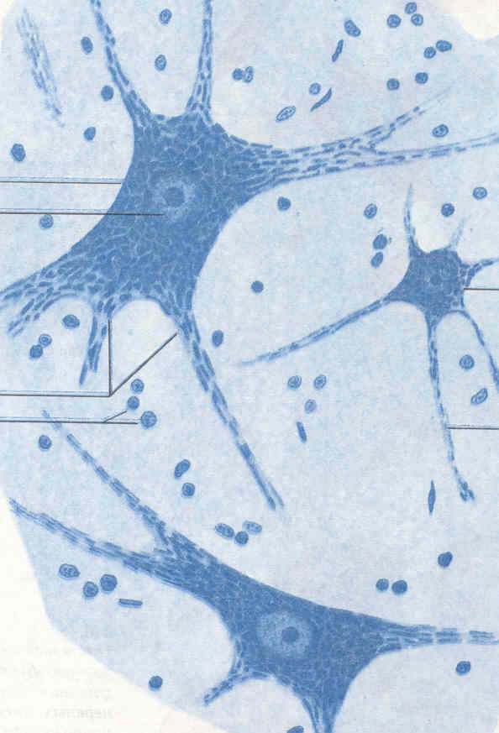

Slide 19
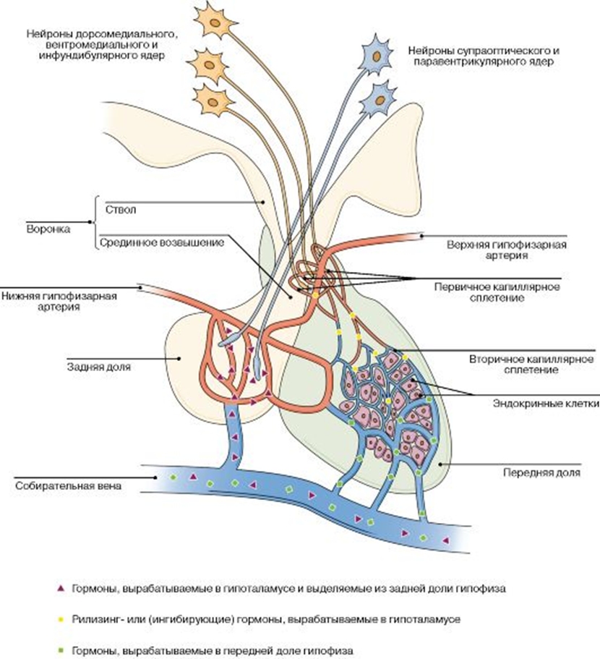

Slide 20
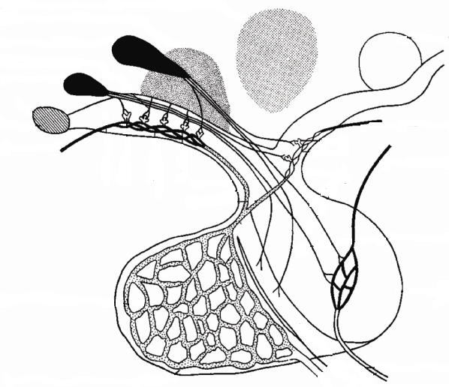

Slide 21
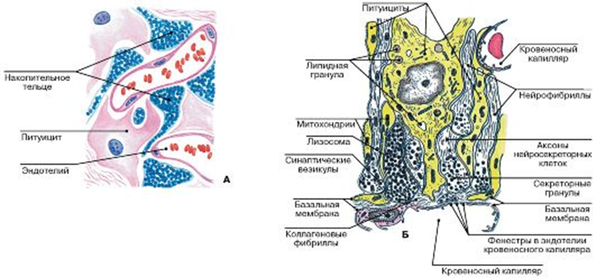

Slide 22
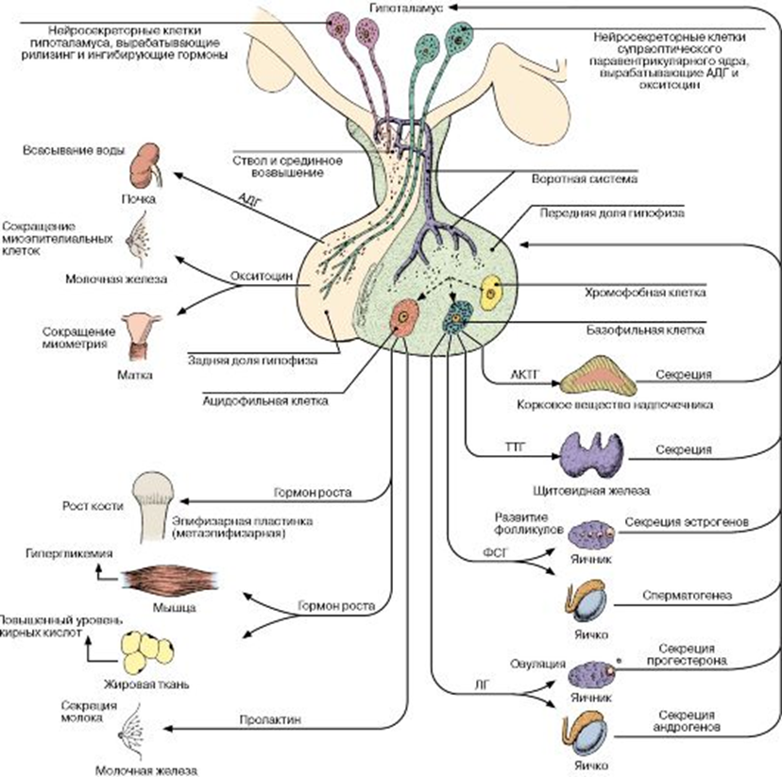

Slide 24
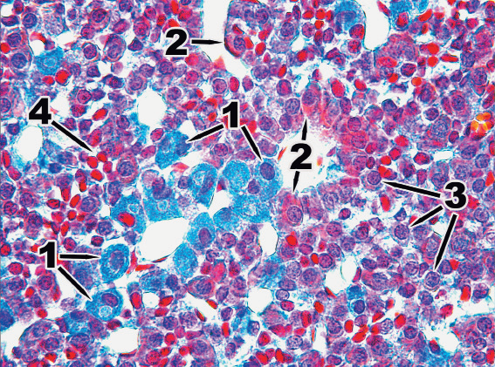

Slide 25
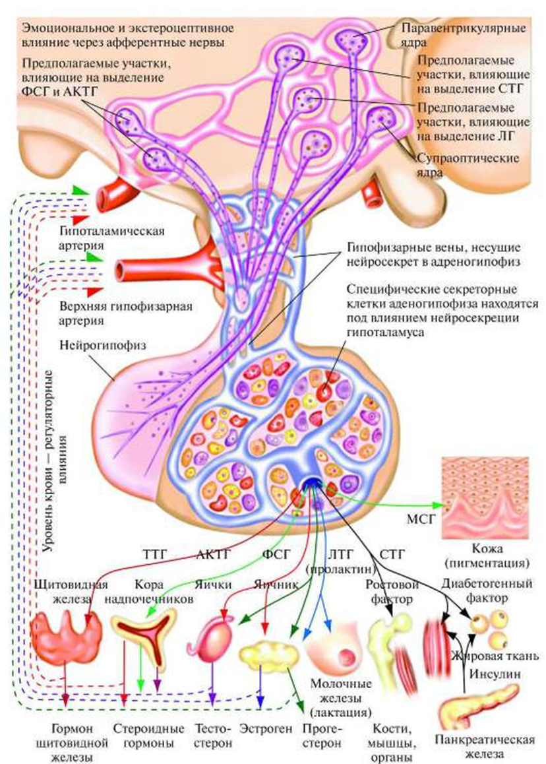

Slide 26
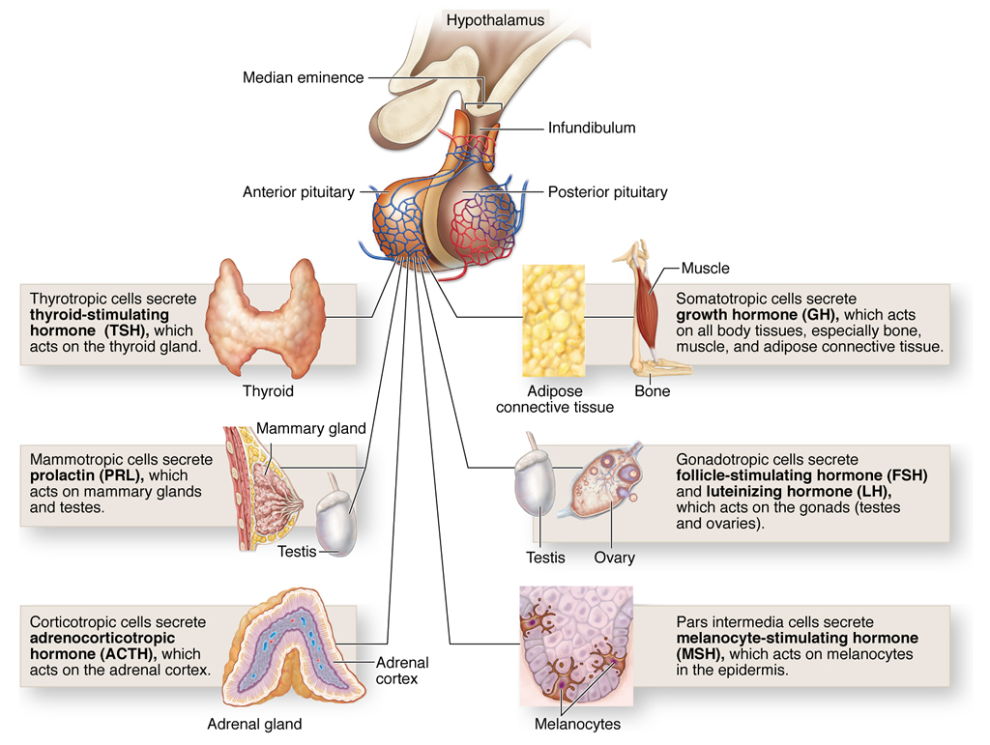

Slide 27
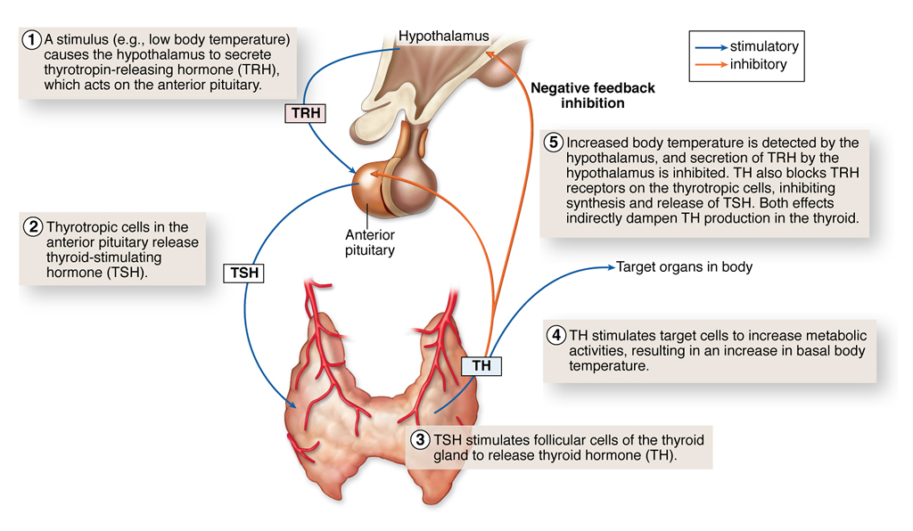

Slide 30
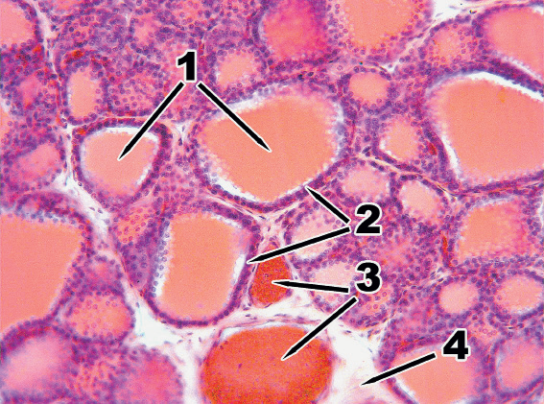

Slide 31
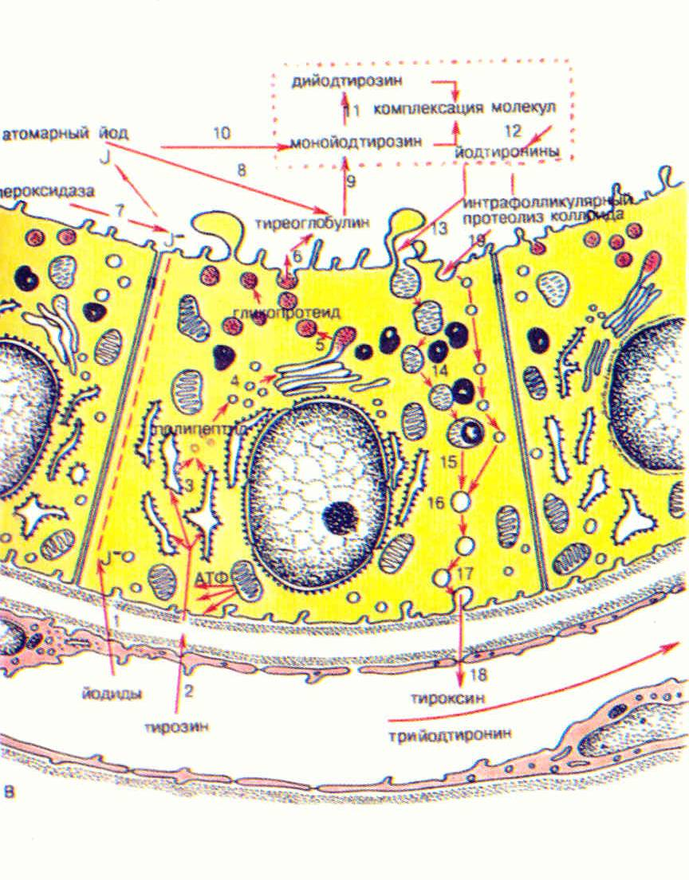

Slide 32
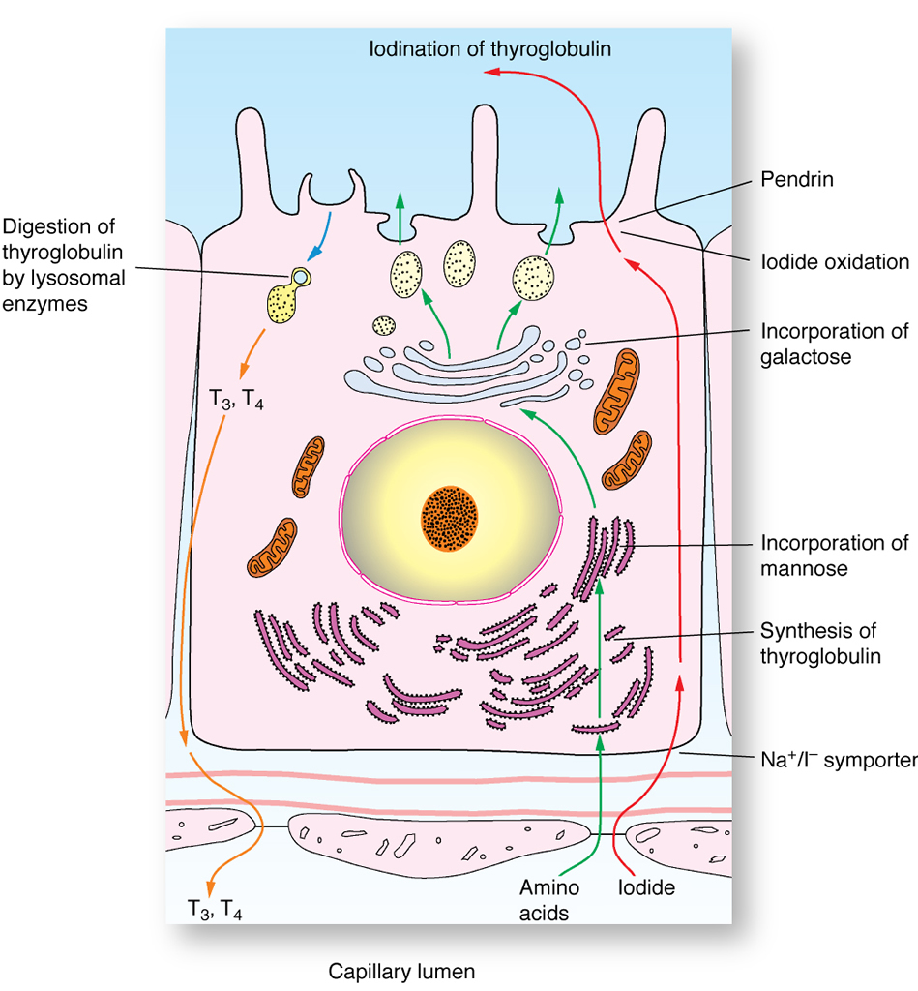

Slide 33
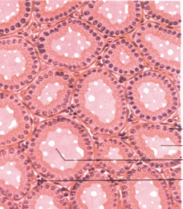
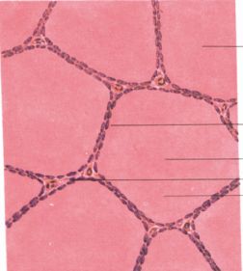

Slide 34
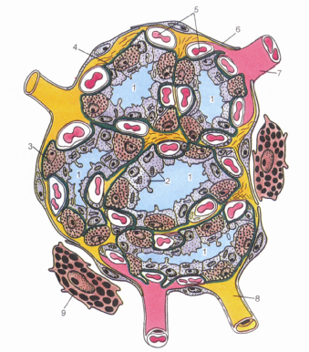

Slide 35
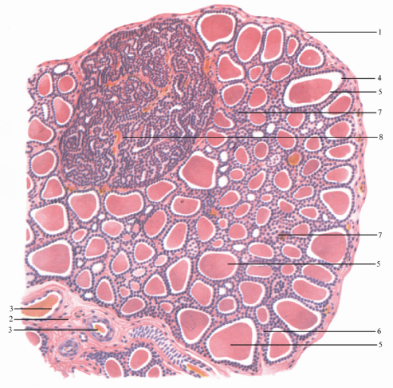

Slide 36
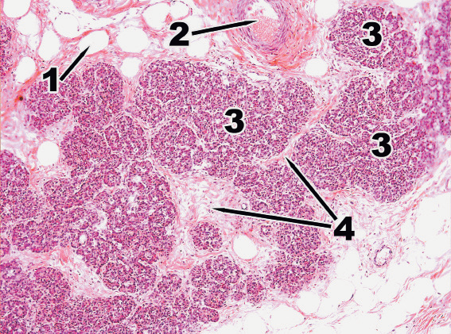

Slide 37
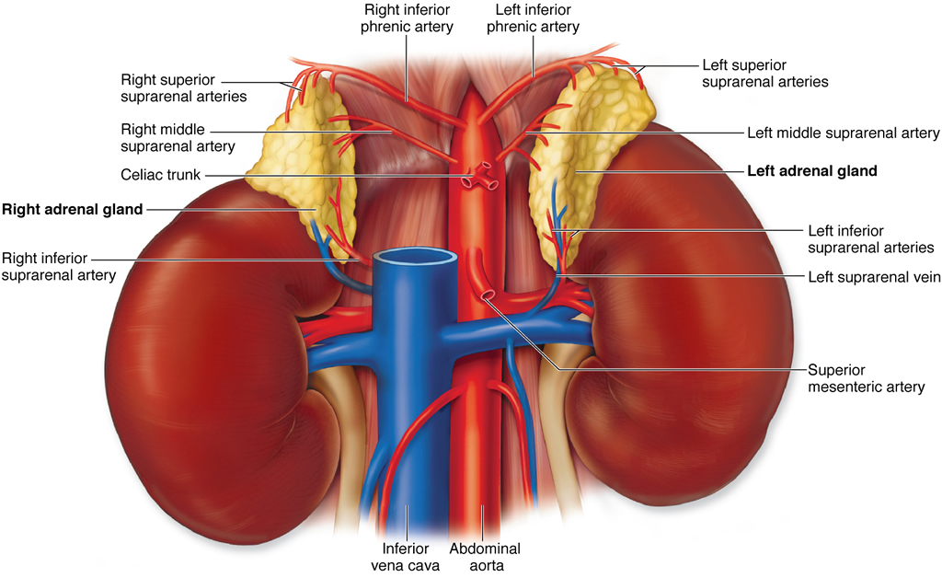

Slide 38
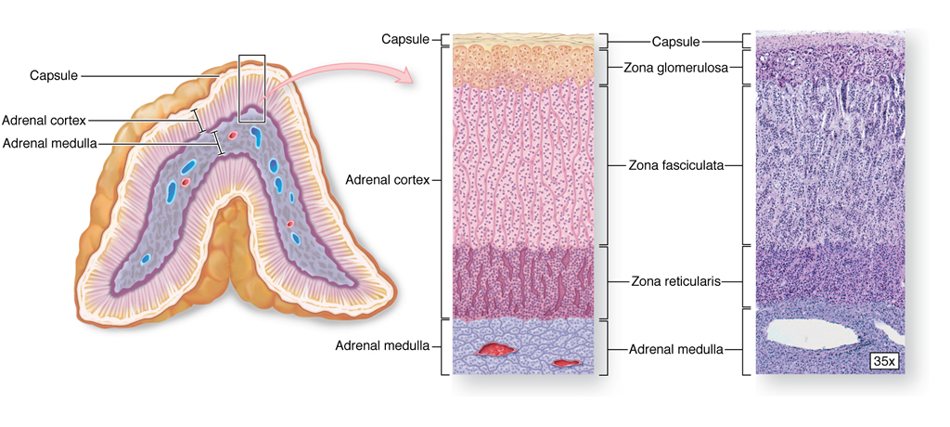

Slide 39
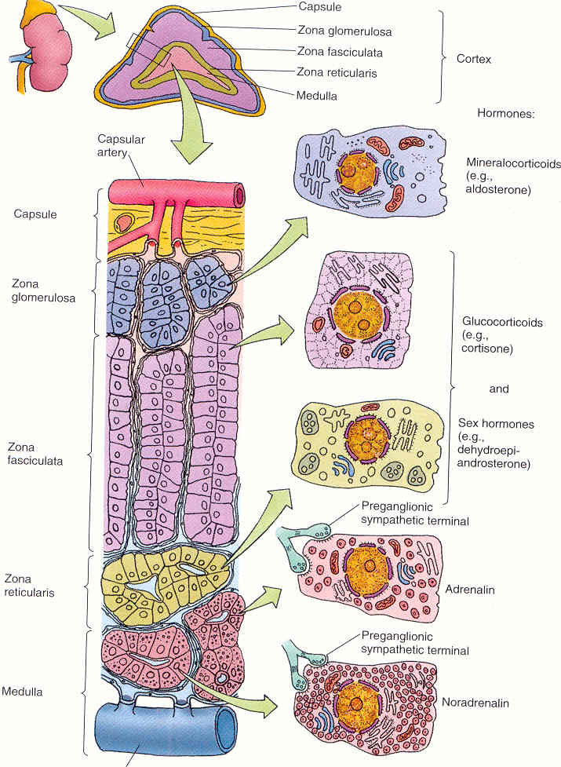

Slide 40
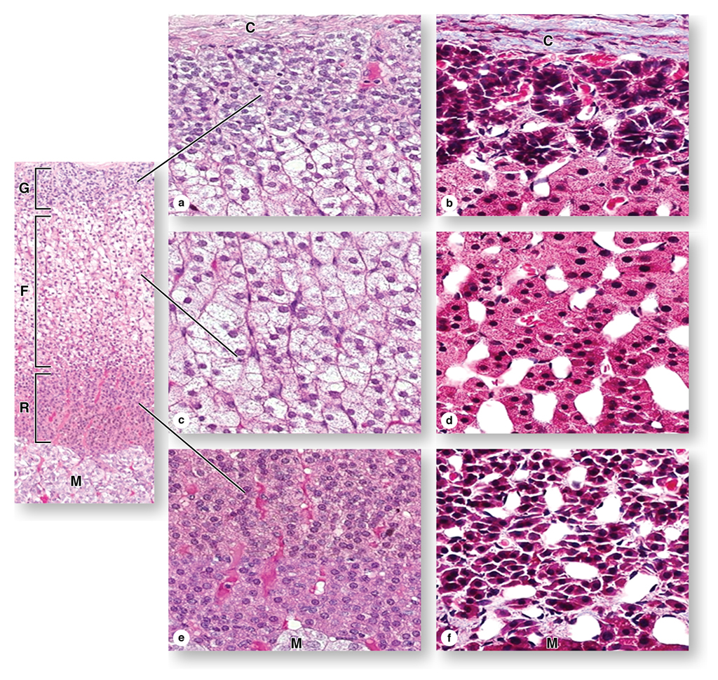

Slide 41
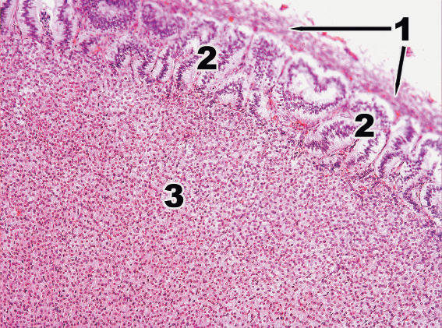

Slide 42
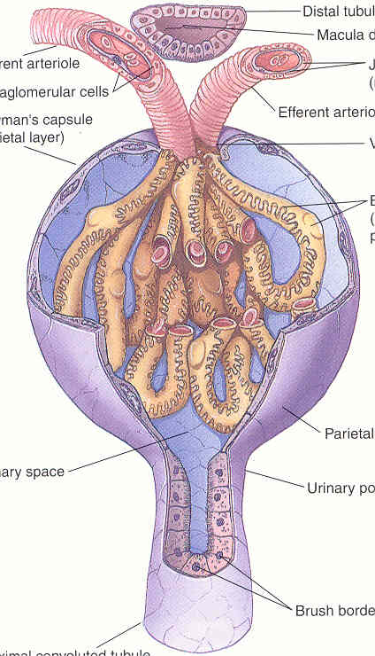
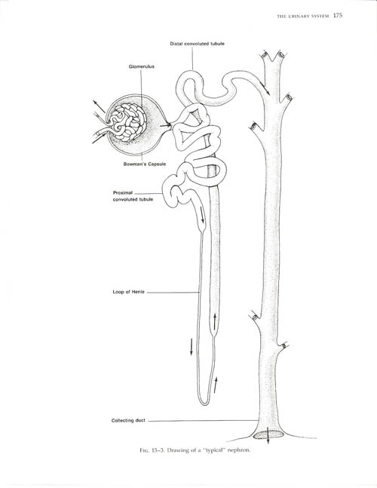

Slide 43
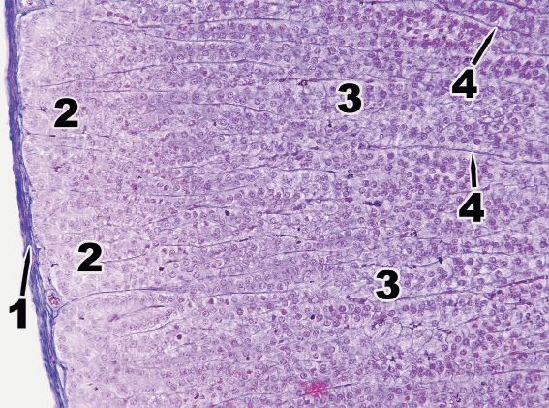

Slide 45
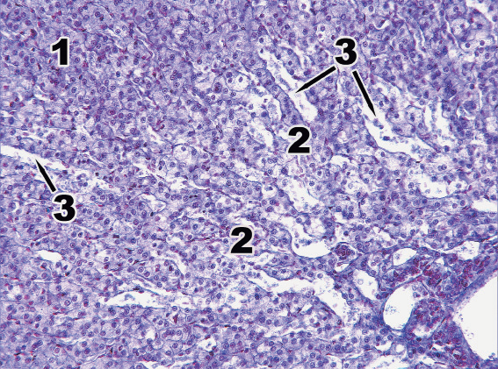

Slide 46
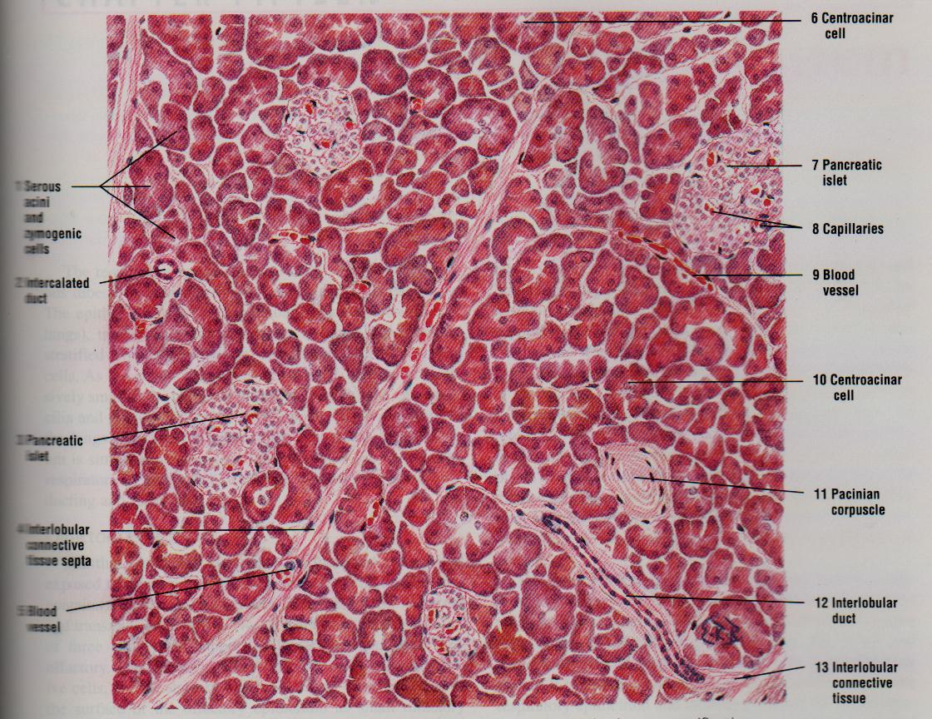

Slide 47
